Slide 1

Financial Analytics
Manoel Fernando Alonso Gadi Associate Professor
manoelgadi@campusciff.net
Sesión 2 - Estadística y la Analítica Financiera
Madrid

Slide 2
Logistic Regression
It is the standard technique in the industry for development of models. Considering p as the probability of bads that you want to estimate, logistic regression model is described in the following way:
The main advantages of logistic regression is that it is a linear model for adjustment of a binary variable, whose estimation of parameters (β) is relatively simple, and which allows to directly estimate p:
The variables explanatory (X) can be of different types: categorical, ordinal or continuous, while in the latter case also can become variables continuous categorical through groupings.
As mentioned before, for the logistic regression model is enough just defining a category of the response variable (bad), since the probability of a "good" can be easily estimated by 1-p.
Therefore, the methodology does not recommends the use of "indeterminate", whose use does not add anything to the model and generate additional work.

Slide 3
Let’s add some measures to our collection
https://dl.dropboxusercontent.com/u/28535341/BadRate_ODDS_WoE_IV.xlsx
Age | #bads | #goods | Bad Rate | ODDS | WoE | IV
18 - 26 years old | 49 | 779 | 5.92% | 15.90 | -0.5091 | 0.017
27 - 47 years old | 339 | 7616 | 4.26% | 22.47 | -0.1633 | 0.014
48 - 60 years old | 127 | 3741 | 3.28% | 29.46 | 0.1076 | 0.003
60+ years old | 54 | 3028 | 1.75% | 56.07 | 0.7514 | 0.079
Missing | 6 | 45 | 11.76% | 7.50 | -1.2604 | 0.009
Total | 575 | 15209
IV | 0.123

Slide 4
Let’s add some measures to our dictionary
Characteristic level
How do we know a model is good?
Logistic regression maximizes the R²
But maximizing R² alone we are putting effort into predicting the numbers 0 and 1 and only the number 0 and 1. The model will output a number between 0 and 1, so anything < 0.5 => GOOD and > 0.5 => BAD, and the model is not good to change this cut-off.
However, in real life, we want to be able to change the cut-off as we wish, therefore we need measures that guarantee the quality of the model beyond the 0.5 mark.
Model level

Slide 5
Let’s add some measures to our dictionary
KS Index (Kolmogorov-Smirnov)
100%
Cumulative percentage of bads
Cumulative percentage of goods
Is defined as the maximum vertical distance between
The cumulative distribution of the goods
The cumulative distribution of the bads
If the curves coincide (random classification)
KS = 0%
If the classification were perfect
KS = 100%
KS = maximum distance between curves
0
Score
100%
Random
Model
GINI Index
Gini = Area between the curve and the random model
The Gini and the KS are related and two statisticians are used to measure the ability that has the model to "separate" between good and bad
Cumulative percentage of good customers
Model
0
Cumulative percentage of bad customers
100%

Slide 6
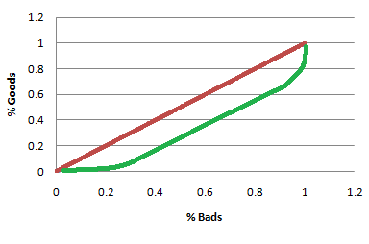
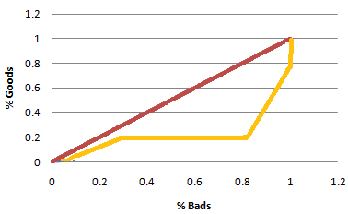
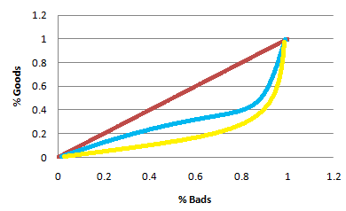
This 2 models have the same R², which one is better?

Slide 7
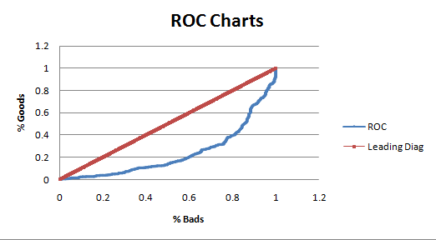
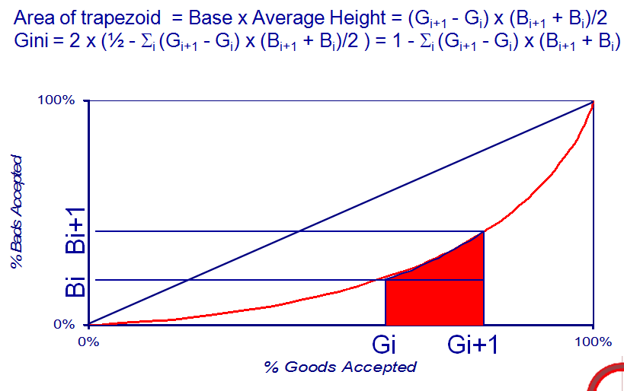
Kolmogorov Smirnov – KS – equivalent to GINI

Slide 8
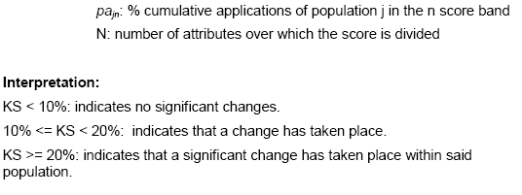
Kolmogorov Smirnov – KS – equivalent to GINI
120
100
80
%
60
% A
K-S = 64%
% B
40
20
0
1
2
3
4
5
6
7
8
9
10
11
12
13
14
15
16
17
18
19
20
21
Score

Slide 9
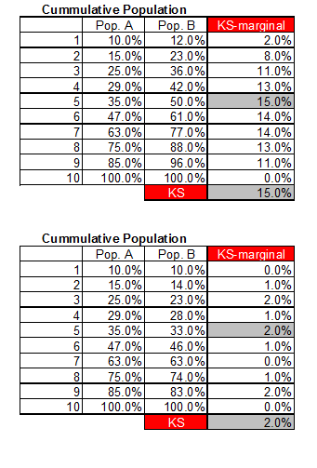
Calculating Kolmogorov Smirnov – KS

Slide 10

Outcome variable
Loan take up
initiation
Loan closing
18 months later
.....................
Ideal exposure is 18 months, but we may dead by then
Paid total
Paid a percentage
Paid zero
So we need a proxy able to capture the majority of Bads usually between 4-6 months

Slide 11
Outcome variable
Worst Bads
Charge-off
Bads
Debt collection agency
3 or more payments in arrears
2 payment in arrears
Either good, indeterminate or bad depending on the company
Inactive – low utilization
No credit exposure
Small arrears
Goods
Never in arrears
Best Goods

Slide 12
Model development phases
Auto Grouping
Manual Grouping
Dev-Hold out definition
Variable Selection
(Low I.V, Logistic Model Filters)
Modelling Stage
(Modelling, Correlation, Marginal χ²)

Slide 13
Financial Analytics
Manoel Fernando Alonso Gadi Associate Professor
manoelgadi@campusciff.net
Sesión 2 - Estadística y la Analítica Financiera
Madrid

Slide 14
WoE
Why WoE transform?
Satisfies linearity assumption of logistic regression
To handle outliers
No extremely high/low scores
WoE shape fixed, only scale (βs) change
P₃ = +3.0
18
25
40
85
P₂ = -0.3
AGE
P₄ = -1.5
P₁ = -2.5
Score
Linear Transform:
Replace original values by WoEs
P₃ = +3.0
WoE
P₂ = -0.3
P₄ = -1.5
P₁ = -2.5

Slide 15
WoE
χ² Test
15
Chi-Squared Test:
Is this characteristic predictive?
Null hypothesis, there no difference in bad rates between attributes
1% significance ⇒ 1% chance that observed difference occurred by chance
Dependent upon sample size & weightings.
Marginal Chi-Squared Test:
Does this characteristic add power to the model?

Slide 16
WoE
Information Value
16
Information Value:
How predictive is this characteristic?
Measure of distance, not certainty
0 -< 0.015 No Predictive Power
0.015 - < 0.1 Weak Characteristic
0.1 -< 0.3 Medium Characteristic
0.3 -< 0.5 Strong Characteristic
> 0.5 Suspicious Char
Marginal Information Value:
How much power does this characteristic add to the model?
where

